Slide 1

Descriptive Statistics in Colab
Data Analytics Department Bridgerland Technical College

Slide 2

Lecture using Colab
In the next files, you will find different screenshots showing how to use Scikit-Learn in Colab.
Read and analyze the information given in the next slides
You will find a blank template on Canvas so you can create your own version of that lecture information provided

Slide 3
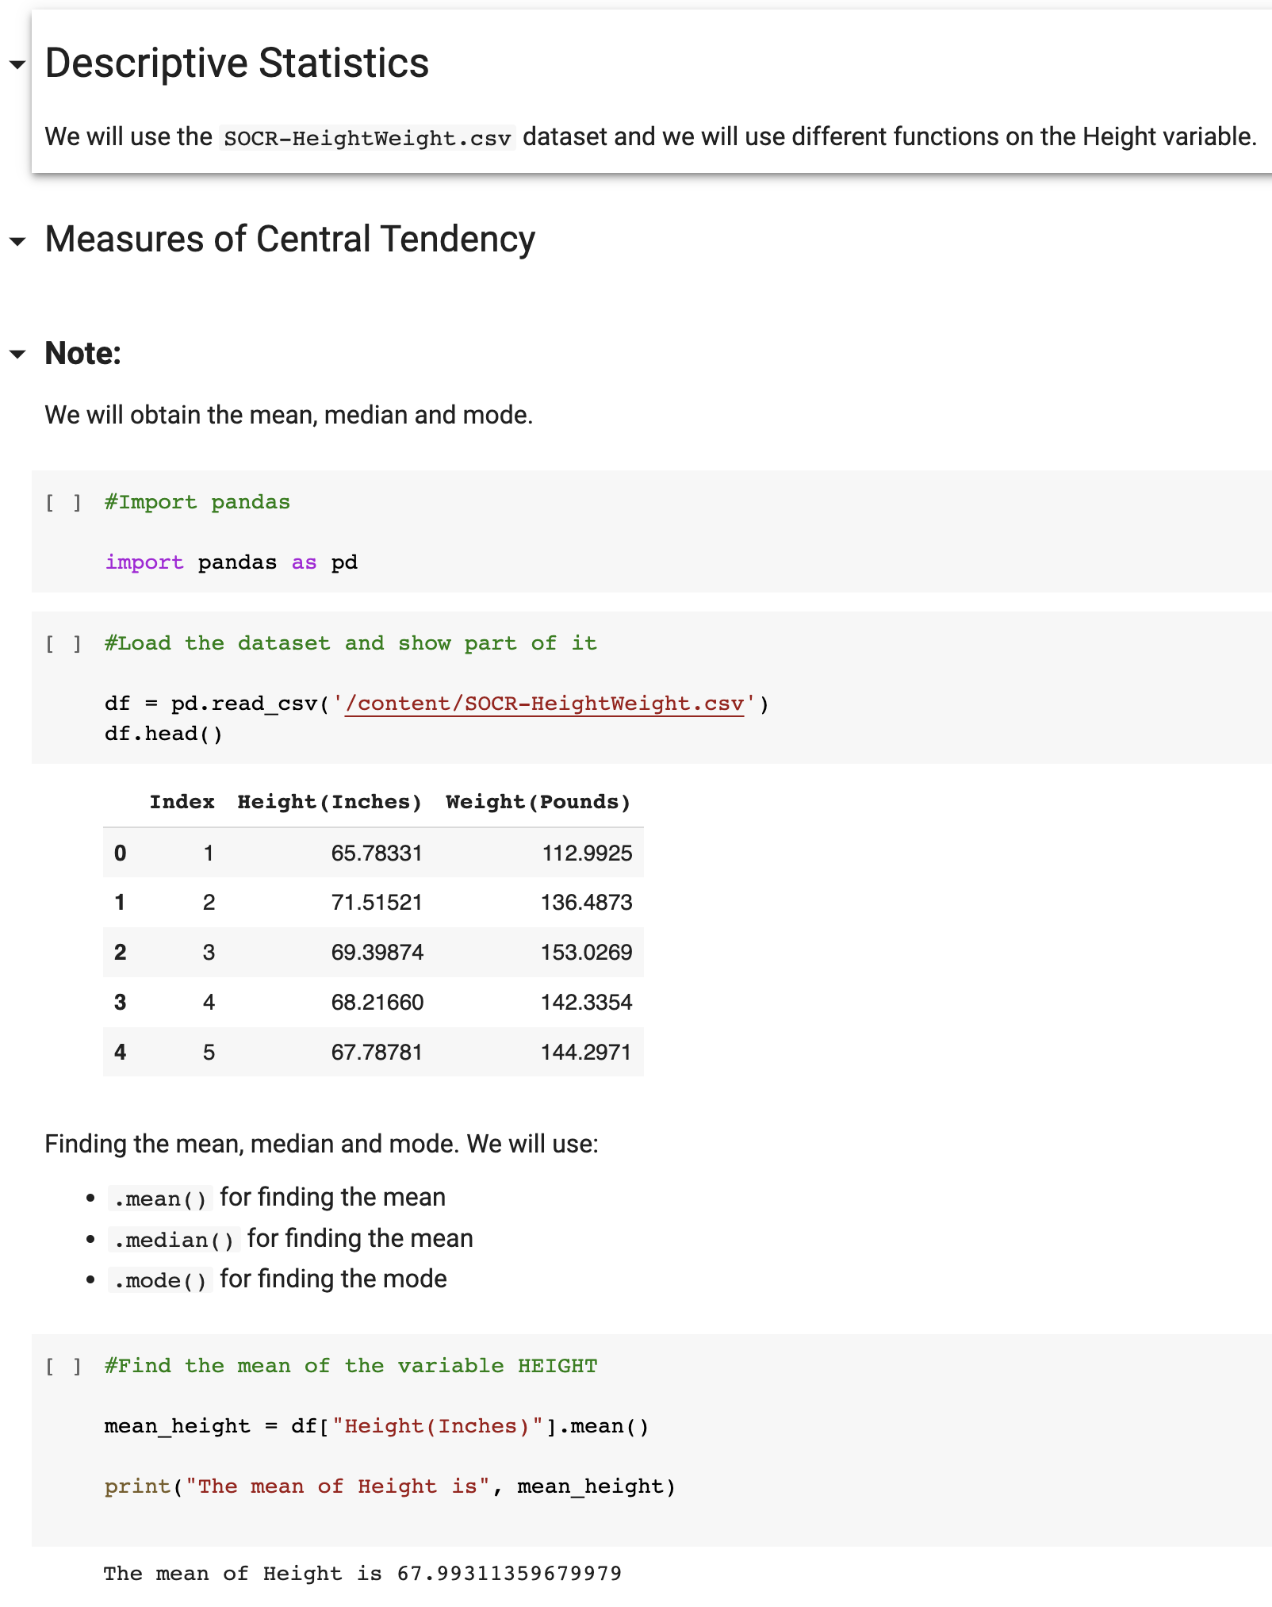
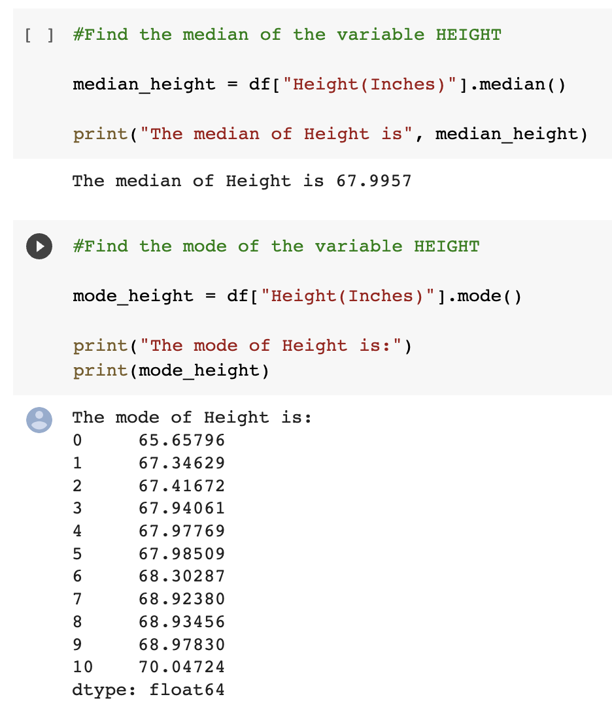

Slide 4
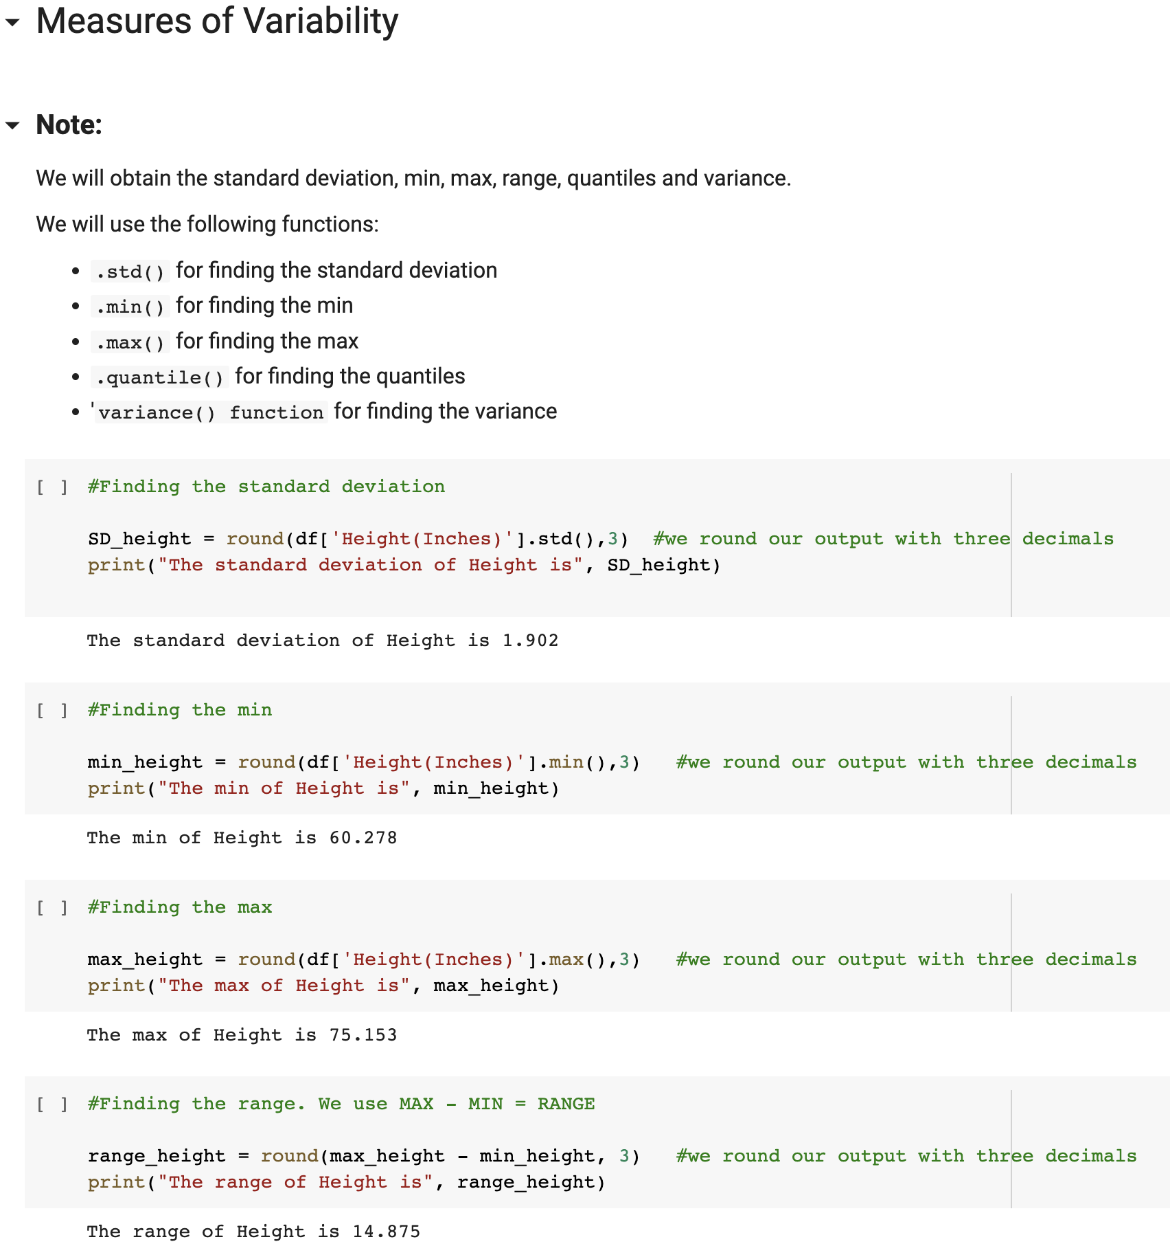
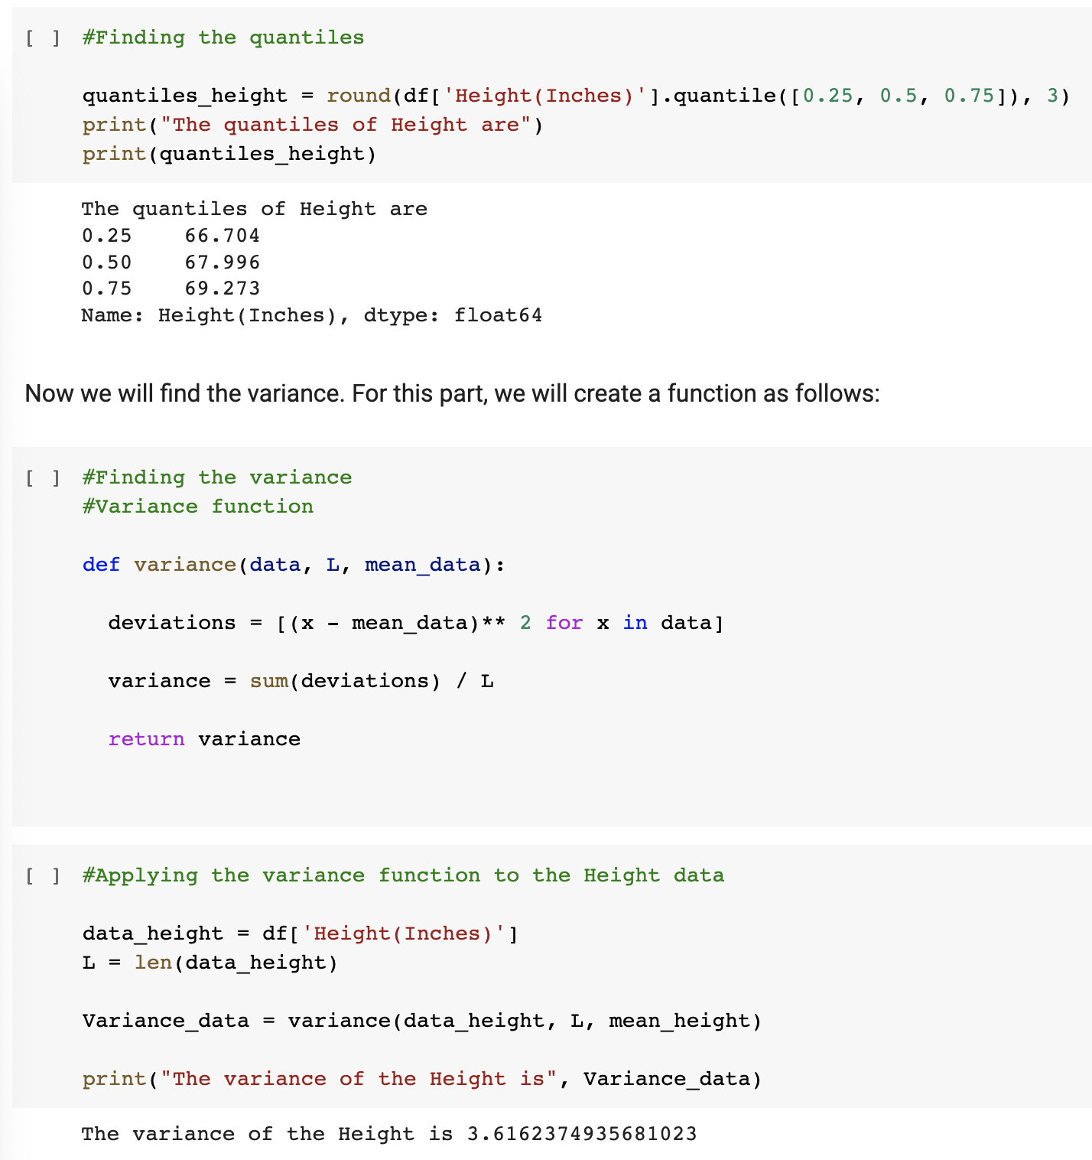

Slide 5
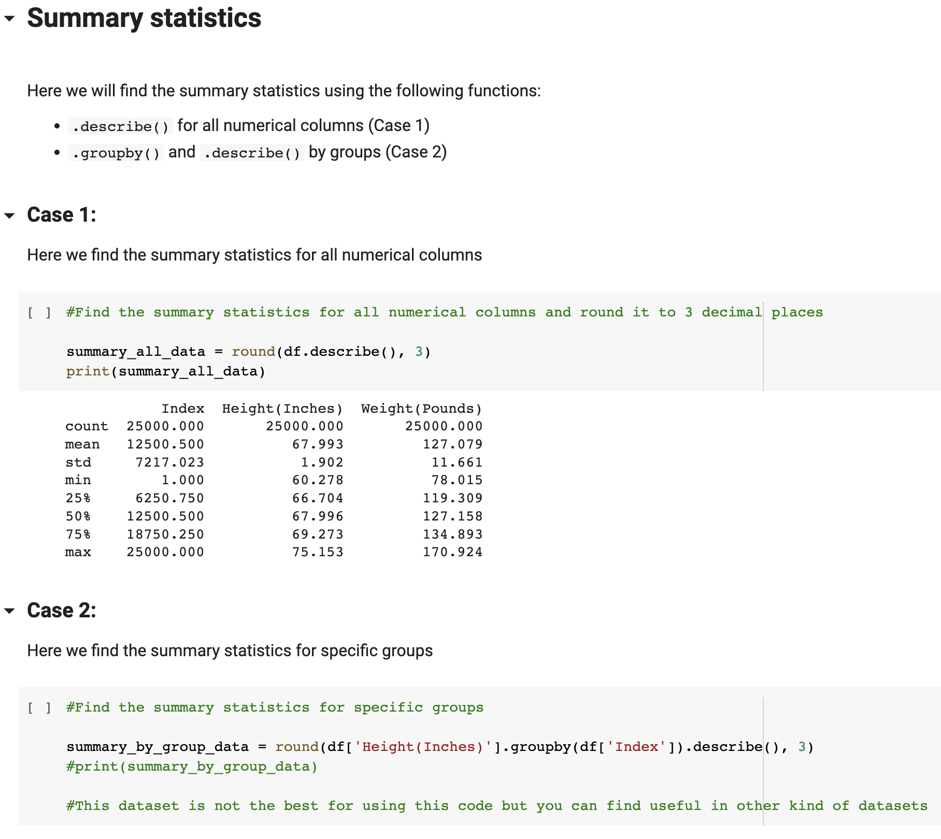

Slide 6

Questions?

